Slide 1
Make You Up In Video
Group 25: r06922055 吳均庭
r07922153 八巻櫻

Slide 2
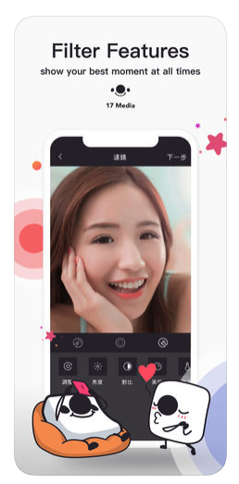
Motivation
People want to looks more appealing and stylish in their video but people are lazy.
Existing applications provide some pre-defined filter for their users, however most of them are not customizable.
Our goal transfer makeup from a reference image onto a non-makeup video

Slide 3
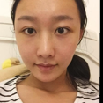
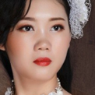
Problem Definition
Non
makeup
Face
Model
Style
Generated
image
Makeup

Slide 4
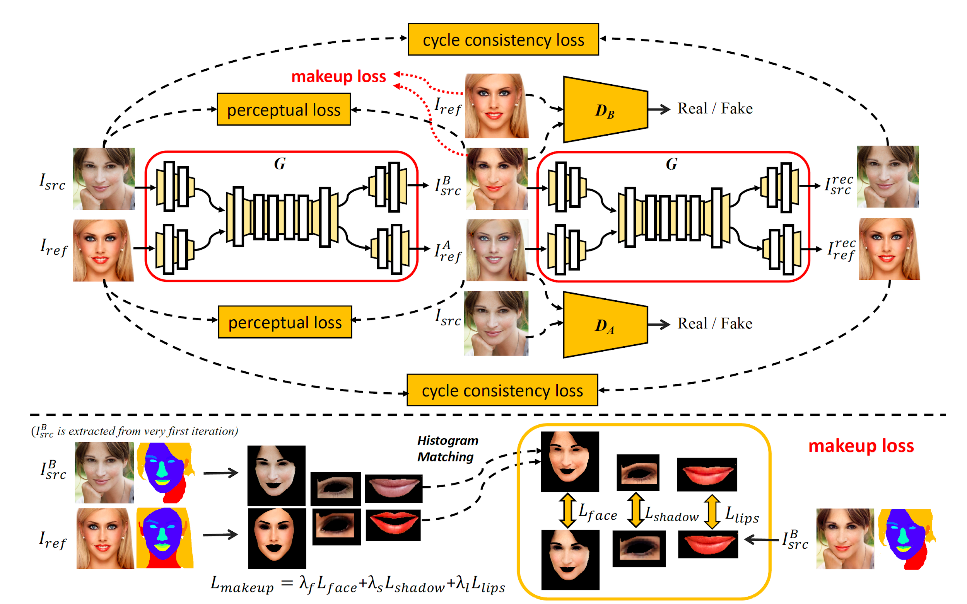
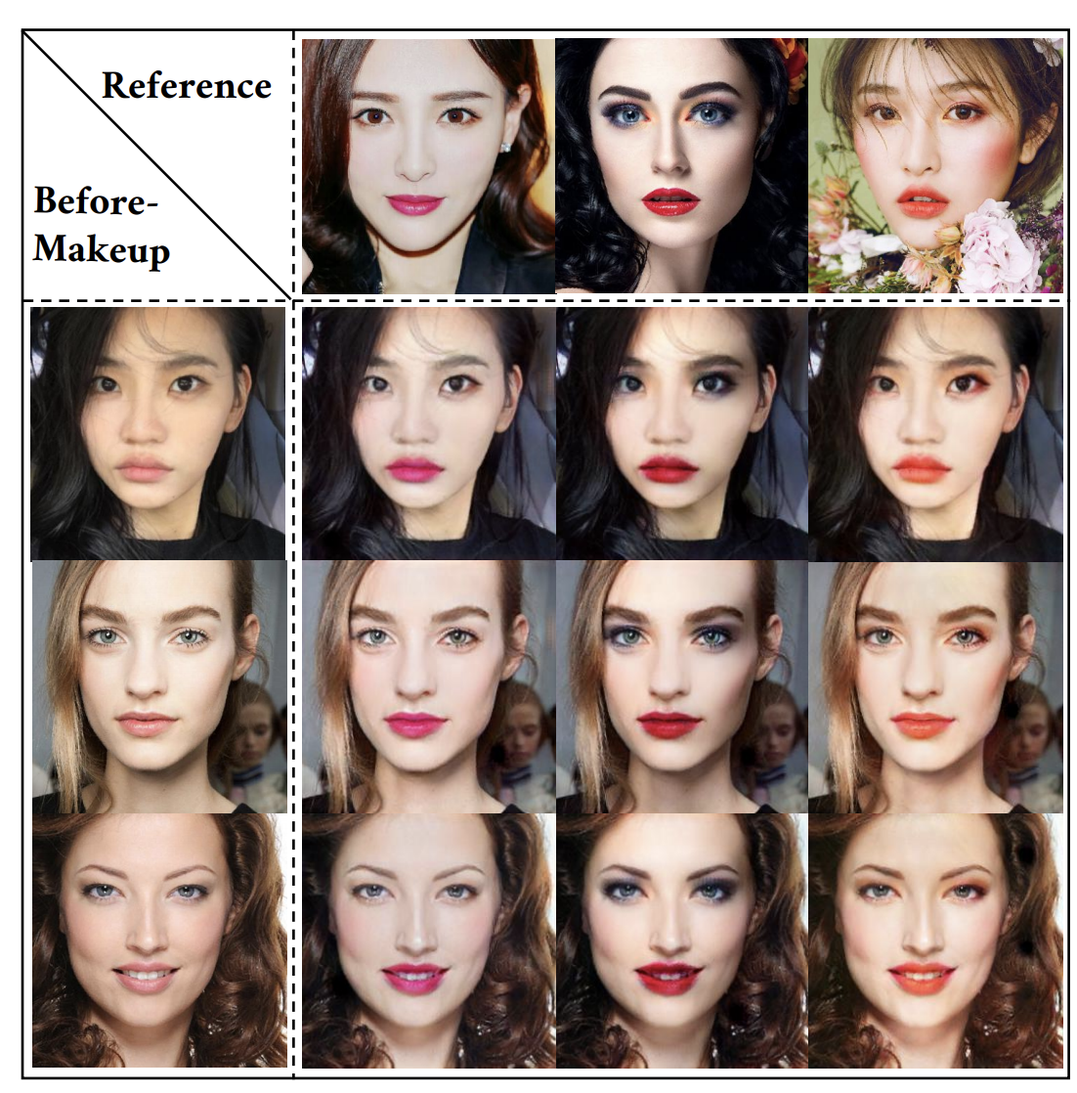
Tingting Li, BeautyGAN: Instance-level Facial Makeup Transfer with Deep Generative Adversarial Network, SIGMM 2018

Slide 5
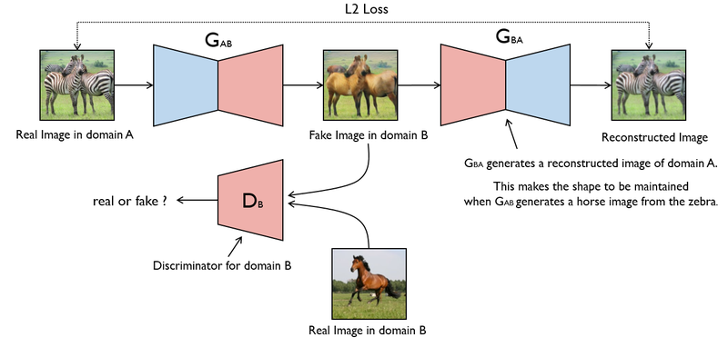
One Page cyclegan

Slide 6
Model : BeautyGAN (1/6)
The lower pipeline shows the overall system.

Slide 7
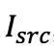
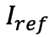
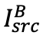
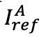
Model : BeautyGAN (2/6)
<STEP1>
G accepts 2 images as inputs:
non-makeup image
reference makeup image
And generates 2 outputs:
transferred makeup image
antimakeup image

Slide 8

Model : BeautyGAN (3/6)
<STEP2>
The generated images are fed into the same G to build up reconstruction results:
≈

Slide 9
Model : BeautyGAN (4/6)
<STEP3>
There are four loss terms for training G:
adversarial loss
cycle consistency loss
perceptual loss
makeup loss

Slide 10

Model : BeautyGAN (5/6)
<STEP4>
The lower pipeline shows the details of makeup loss. It consists of three local histogram loss terms acted on
Face
Eye shadow
Lips
We first utilize face parsing model to separate each cosmetic region of
≈

Slide 11
Model : BeautyGAN (6/6)
<STEP5>
Then, for each region, we employ histogram matching between
and to obtain a histogram remapping facial region as ground truth.
The local loss term calculates pixel-level differences between such ground truth and corresponding cosmetic region of

Slide 12
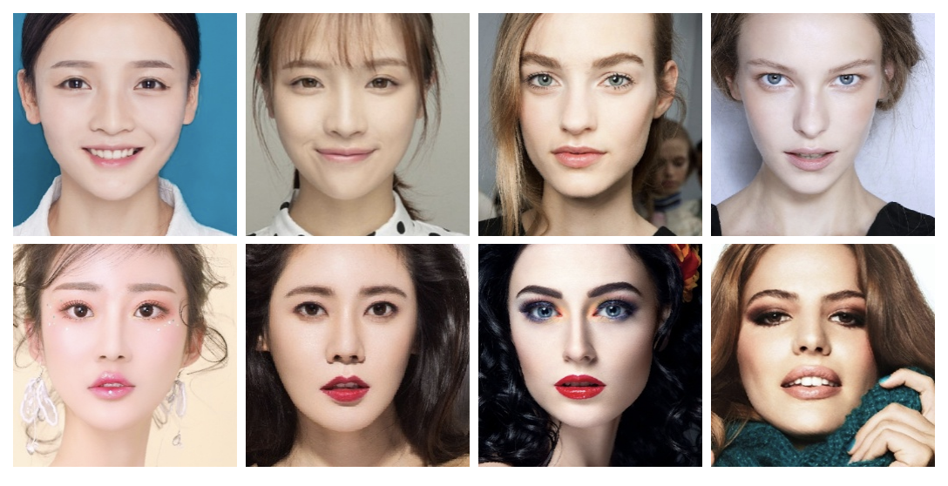
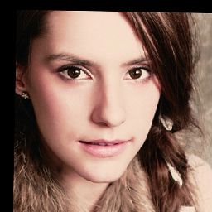
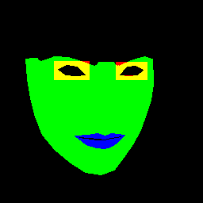
Implementation
Implement using Tensorflow
MT dataset:
Non-makeup : 1115
Makeup : 2719
Dlib is used for face parsing

Slide 13
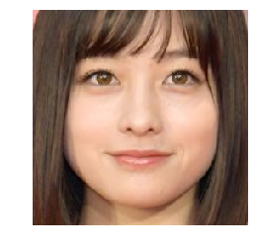
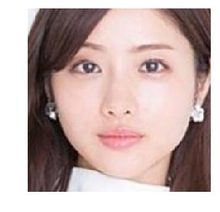
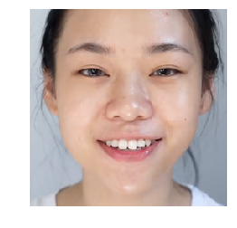
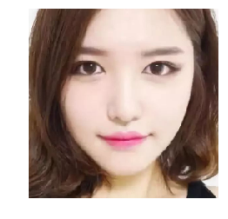
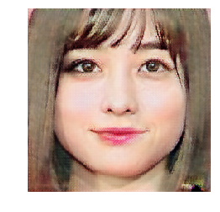
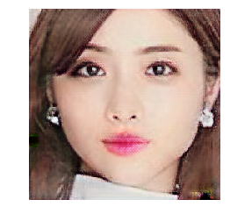
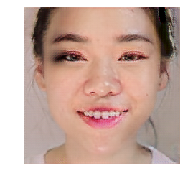
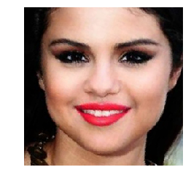
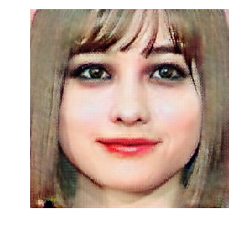
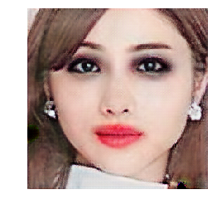
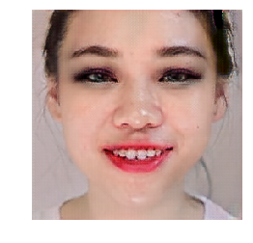
Results

Slide 14


Apply to Video
Apply the sample makeup to a input video
Model
Styled Video

Slide 15
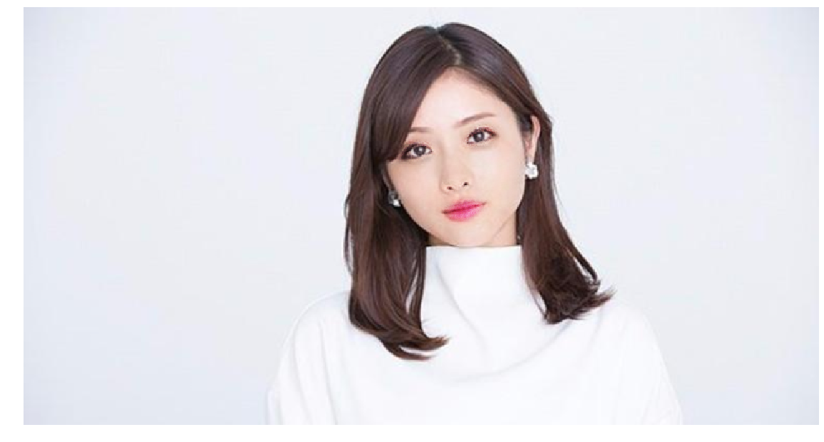

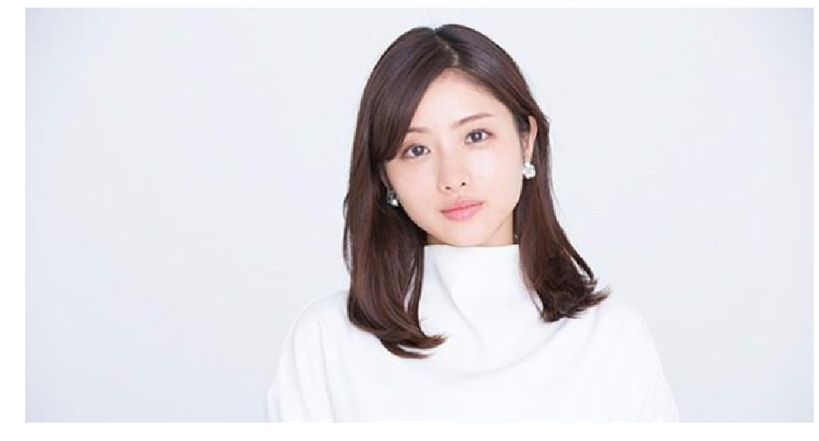
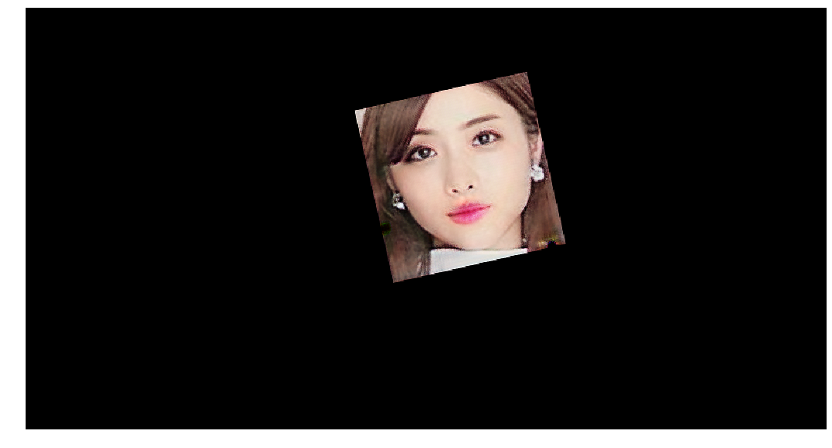
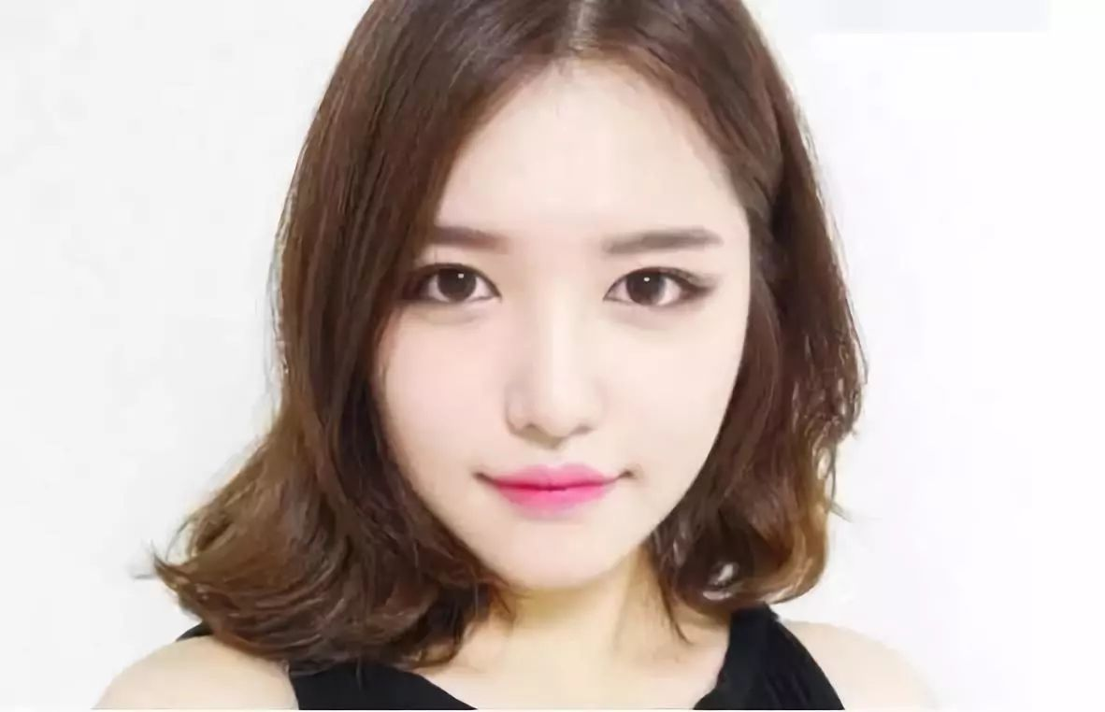
How to apply makeup to Image
Mask
Weighting, Gaussian blur, Erosion, ...
m1
BeautyGAN
(m1)⁻¹
m2

Slide 16

Result

Slide 17
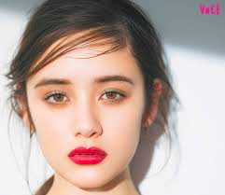
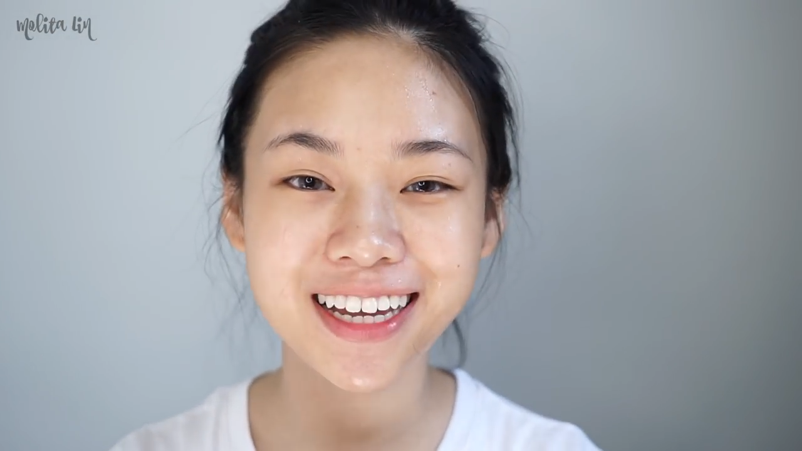

Applying to Video
Makeup image

Slide 18
Future work
The whole pipeline takes about 0.5 sec for a single frame, not fast enough for real-time usage.
Replace Dlib face parsing with NN based method to improve the result
Histogram matching only preserve the make-up color tone, but the detail are ignored

Slide 19
Reference
J.-Y. Zhu, T. Park, P. Isola, and A. A. Efros. Unpaired image to-image translation using cycle-consistent adversarial networks. arXiv preprint arXiv:1703.10593, 2017. 1, 3
Li, Tingting & Qian, Ruihe & Dong, Chao & Liu, Si & Yan, Qiong & Zhu, Wenwu & Lin, Liang. (2018). BeautyGAN: Instance-level Facial Makeup Transfer with Deep Generative Adversarial Network. 645-653. 10.1145/3240508.3240618.

Slide 20
Thank You!

